Slide 1
LESSON SEVENTEEN
TOPICS: HOW TO PROGRAM RANDOM POSITIONS FOR OBJECTS

Slide 2
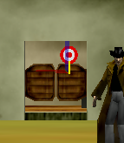
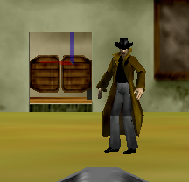
Step 1: Create the First Target Position
Drop a new dummy object named “doorTarget” at the Saloon’s right door.
Move the doorTarget right 0.5 meters, and up 0.25 meters.
Set the point-of-view of the Target’s stick to that of doorTarget.
Turn the Target’s stick backwards 0.25 revolutions.
Set the opacity of all of the parts of the Target to “0.”

Slide 3
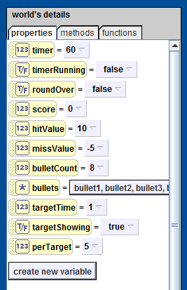
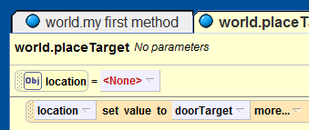
Step 2: Create the Global Target Variables
Create new world Number variables targetTime and perTarget.
Set the initial value of perTarget = 5.
Create a new world Boolean variable named targetShowing.
Add a local Object variable named “location” to the “world.placeTarget” method.
Set the value of the “location” variable to “doorTarget”.

Slide 4
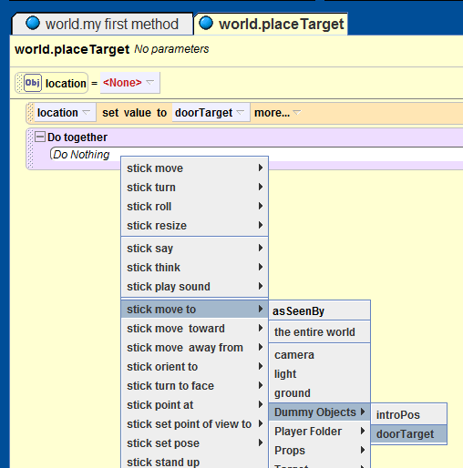
Step 3: Create the world.placeTarget Method
Add a “Do together” to the “world.placeTarget” method.
Add the line “stick move to doorTarget,” with duration 0.
Also, add a call to the “world.targetOpacity” method, with opacity set to 1, and duration set to 0.
Drag-and-drop the stick into the do-together block make a call to “turn forward 1/4 revolutions.”
Drag-and-drop the targetTime into the bottom of the Do-together block and set its value to world.timer.
Drag-and-drop the “world.targetShowing” variable into the end of the Do-together block and set its value to true.

Slide 5
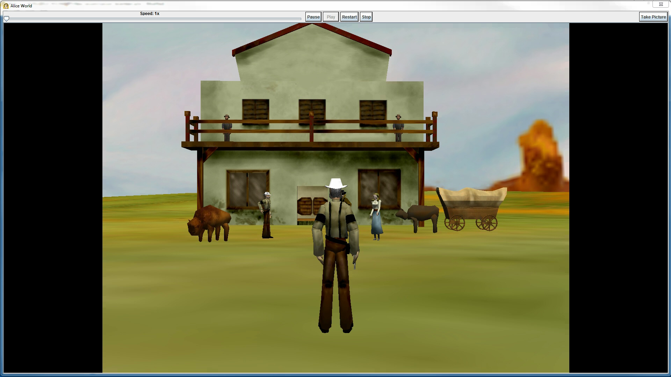
Final Scene

